Slide 1

Analysis of Financial Models and their Assumptions Data606: Deliverable III Spring 2020 - Joe Knapp
Notes:
My name is Joe Knapp and this is Deliverable 3 for my capstone project on evaluating financial models and their assumptions
https://youtu.be/RKOTsQMN7b0

Slide 2
Project
Many financial models have been created based on different assumptions
Are the Assumptions Valid?
Are the Models Valid?
Running simulations on many of the simple models
Having trouble with speed of computations
Notes:
Again I will be evaluating financial models performance
Most of these models are relatively simple and based on fundamental financial theory's
My hope is to find some well performing models, and create an ensemble of the models, which together can predict relatively accurate probabilities of stock returns
Currently I am only working with stocks in the S&P500 with consistent data between 2010 and 2020 but I hope to look at other stocks not in the S&P eventually.
Of specific interest is less expensive stocks in general, I’m interested in apply my models to stocks which I could afford, but for now I will evaluate my models using stocks in the S&P.

Slide 3
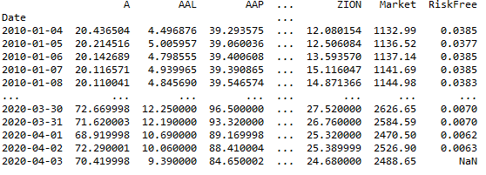
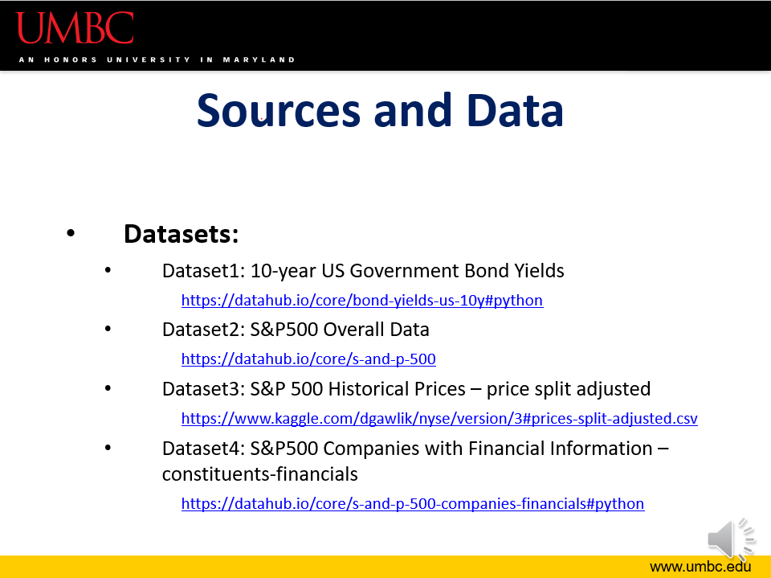
Data Source Update
Found better ways to get data
Was using downloaded files from Kaggle and other sites
API’s are awesome
Yahoo Finance API
FRED API
Notes:
As of deliverable 2 I was using datasets from various sources on the web.
I have since been getting data through Yahoo’s yfinance API and the FRED API.
This will make it much easier to explore many more stocks and possibly financial options.
The dataset you see here is a snapshot of the time-series data set I have compiled. Each column represents historical prices of that stock.
It includes all stocks in the S&P500 with valid data, as well as S&Pmarket data and the risk free rate issued daily by the FED.

Slide 4
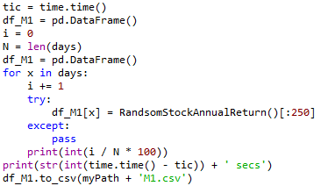
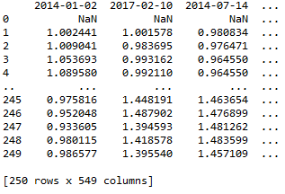
Analysis Method
Repeat until data stabilizes
Chose a random date from the dataset
Run the model on every stock to find the best stock based on the model
Record the daily returns of the stock over the next 250days and calculate annual return
Add the daily returns to a master data frame
Notes:
My analysis method for the models is a very simple monte carlo simulation.
First: a random date from the dataset is chosen
Second: a model is applied to every stock in the dataset on that specific date using the stocks historical data
Each model has a metric where the magnitude implies a good or bad stock, better or worse, and the stock with largest ‘good’ metric is chosen for that date
That’s stocks next 250 days worth of stock return data is added to a dataframe
This process is then repeated many many times.
I am constricted by two limiting factors when it comes achieving a stabilized distribution
The data in the presentation is from running each simulation 500.

Slide 5
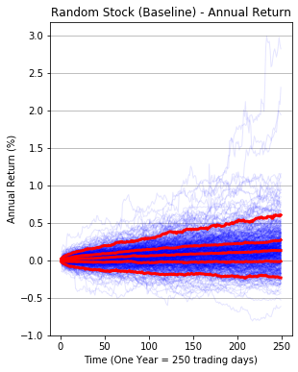
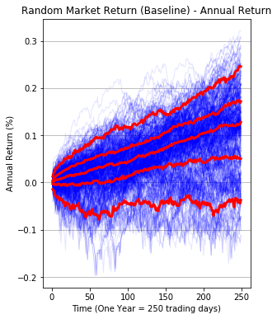
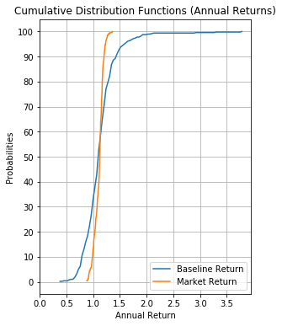
Baseline Models
Random stock on random day
Invest in Market on random day
Notes:
So first I wanted to get some baselines for comparing my models
The first model, depicted on the left, shows the distribution of returns, if on a random day, you bought a random stock
Each of the blue lines represent a single sample of the simulation, and together they provide a distribution of returns.
I can analyze the probabilities of different levels of return and evaluate each models performance.
The redlines throughout this presentation will represent the 5th , 25, 50, 75, 95th percentiles of the annual returns of that model
Note the y-axis is Annual Return %. A return of 0.0 means you broke even, a return of 1.0 means you doubled your investment
However I made the CDF graph on the right means an Annual Return of 1.0 is breaking even, and a return of 2.0 doubled return.
The model in the middle shows the distribution of returns, if on a random day, you invested in the S&P500 market index.
The graph on the right is the CDF of the annual returns of the two models.
The CDF shows probability of receiving an annual return that is less than a specific rate.

Slide 6
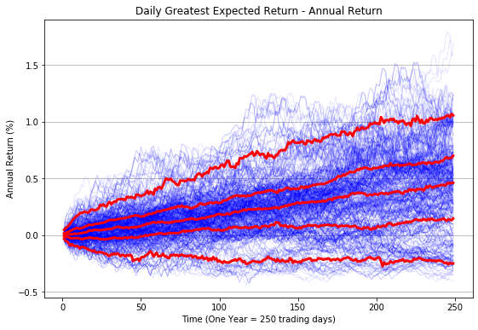
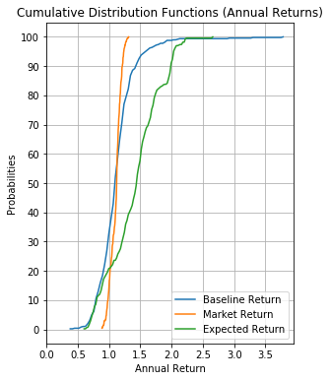
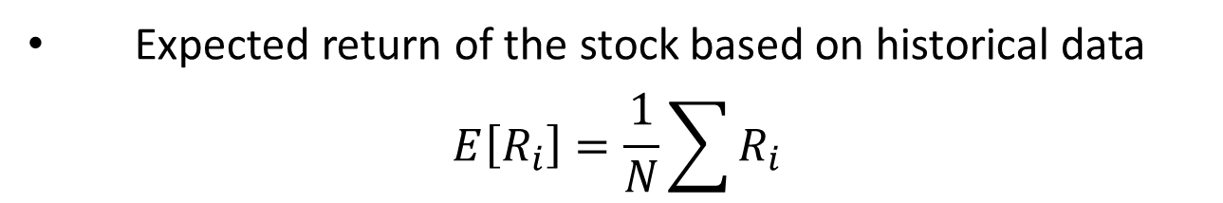
Expected Return Model
Expected return of the stock based on historical data
$$E\left[R_{i}\right]=\frac{1}{N}\sum{R_{i}}$$
Notes:
The first and simplest model that involves calculations is what I call the Expected Return Model.
First the model randomly selects a date within the dataset,
Next if loops through ever stock in the datasets and returns the stocks with the greatest expected return as of the previous date
The selected stocks next 250 days worth of returns are added to a data frame as a column
And this process is repeated 500 times.
Looking at the CDF graph on the right you can see this model outperforms both benchmarks.
Most of the Expected Return line is to the right of the benchmarks
This implies that for a given probability, the annual return is below a higher limit.

Slide 7
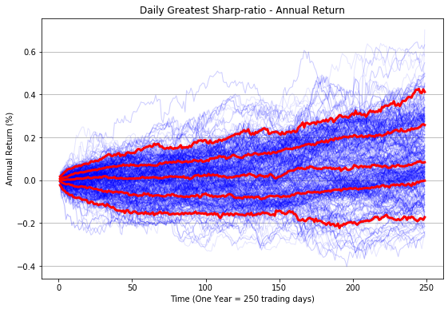
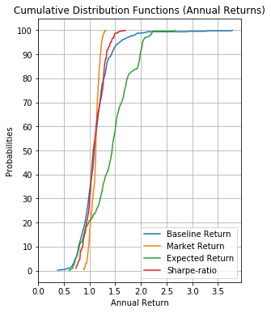
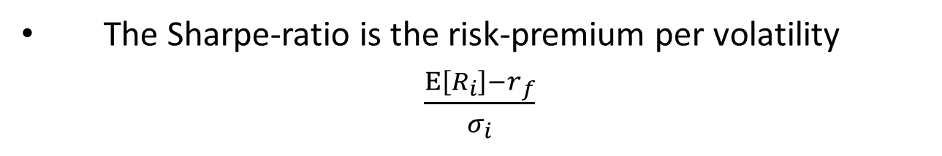
Sharpe-ratio Model
The Sharpe-ratio is the risk-premium per volatility
$\frac{E\left[R_{i}\right]−r_{f}}{σ_{i}}$
Notes:
The next very simple model is what I call the Sharpe-ratio model.
The Sharpe-ratio is a measure of the risk premium (Expected return of a risky investment minus the return of a risk-free investment, 10-year T-Bill rate) per level of volatility
Looking at the CDF graph on the right you can see this model does not perform well at all, some where between the two benchmarks.

Slide 8
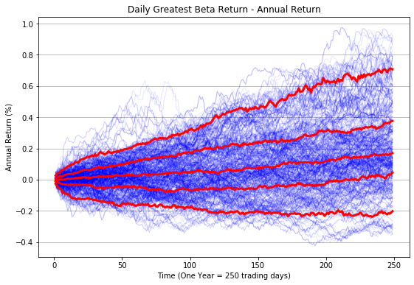
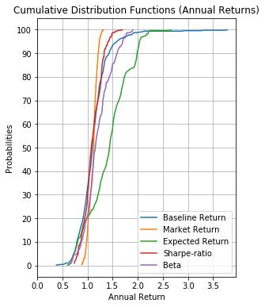
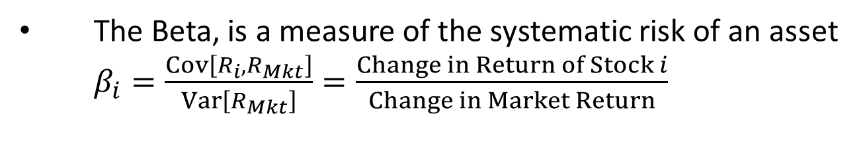
Beta Model
The Beta, is a measure of the systematic risk of an asset $β_{i}=\frac{Cov\left[R_{i},R_{Mkt}\right]}{Var\left[R_{Mkt}\right]}=\frac{Change in Return of Stock i}{Change in Market Return}$
Notes:
Here we have what I call the Beta model.
The Beta of an asset is the % change in the assets return per a 1% change in the market
In deliverable two I spoke more in-depth about systematic and nonsystematic risk.
Recall that systematic risk, is market wide, nondiversifiable, and investors demand a premium for holding systematic risk
Nonsystematic risk can be diversified away with a large portfolio, and thus no compensation is given bearing nonsystematic risk
Because I am interested in stocks which are riskier, I am interested in the returns of stocks with large betas.
Looking at the CDF graph on the right you can see this model outperforms both benchmarks slightly but still under performs the Expected Return model.
Perhaps I should try modeling different degrees of Beta.

Slide 9
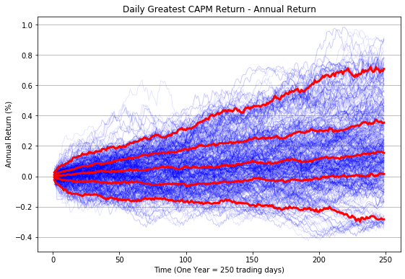
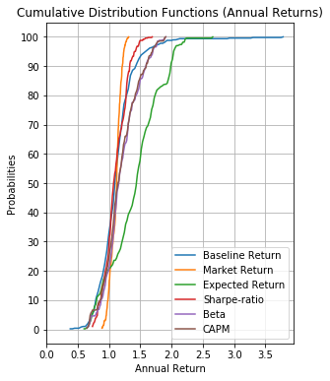
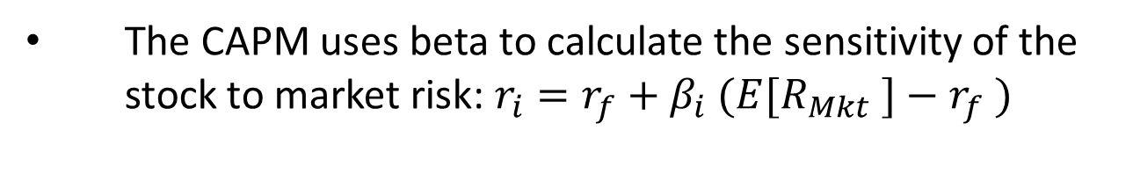
CAPM Model
The CAPM uses beta to calculate the sensitivity of the stock to market risk: $r_{i}=r_{f}+β_{i} (E[R_{Mkt} ]−r_{f} )$
Notes:
The CAPM model is the first true financial pricing model used in industry that I will test.
I also discussed CAPM in greater depth in deliverable two.
Recall CAPM uses the beta of the stock to find the sensitivity of the stock to market changes
The sensitivity is used to calculate its require return given its level of comparable risk.
Looking at the CDF graph on the right you can see this model outperforms both benchmarks.
It follows very closely to the Beta model, which is not surprising given Beta is included in the CAPM model
It too underperforms compared to the simplest Expected Return model

Slide 10
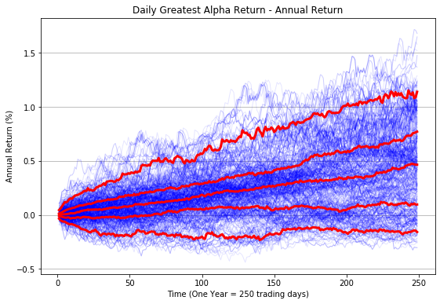
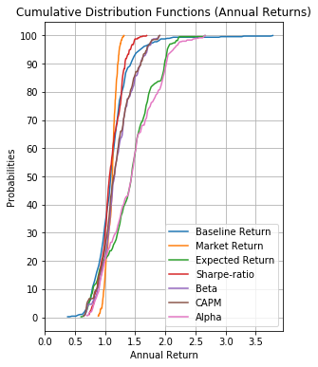
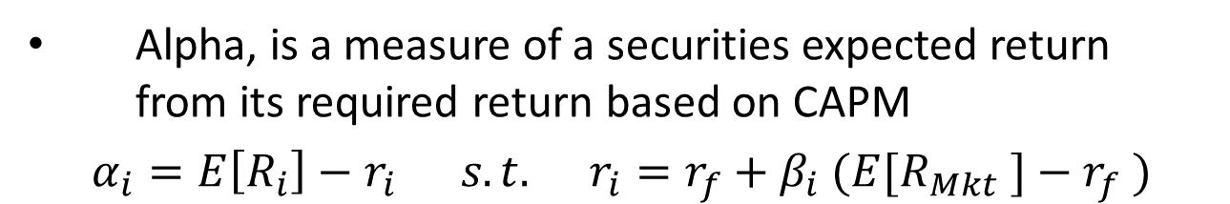
Alpha Model
Alpha, is a measure of a securities expected return from its required return based on CAPM
$$α_{i}=E\left[R_{i}\right]−r_{i} s.t. r_{i}=r_{f}+β_{i} (E[R_{Mkt} ]−r_{f} )$$
Notes:
The last model I have simulated so far is what I call the Alpha model.
The Alpha of an asset is also a well documented calculation in finance.
Alpha is the difference in the Expected Return of a security and the securities required return as calculated with CAPM.
There are several ways to calculate Expected Return of a security but for now I am using the historical arithmetic mean
Looking at the CDF graph on the right you can see this model outperforms all models except the Expected return model which it closely resembles in terms of its distribution of returns.

Slide 11
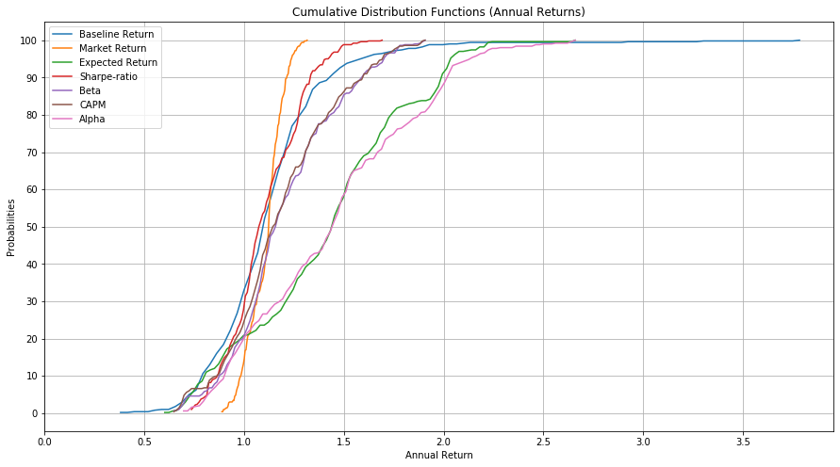
Comparing Models
Notes:
Here you see the same CDF in the last slide just on a larger scale.
I am very interested in getting more data and see if these distributions move a lot.
I am quit excited that such simple algorithms as the Expected Return and alpha show promise consistently.
They both have a 80% chance of breaking even, and 50% chance at a return above 40%, and a 10% chance of more than doubling the investment.
If I can find a couple more quality metrics/models, I believe I can create an ensemble model with decent predictability of a stocks return distribution.

Slide 12
Next steps…
There are still a couple other simple models I would like to test and little tweaks to ones I have already tested I would like to try
So far my computer has been a limiting factor in the amount of data I am able to process, so I will be looking into ways to try to make my coding more pythonic
Any advice would be helpful
I also have data for financial reports and other types of non pricing data I have trying to find ways to put to use
The ideas are limitless, my computational power is not
Notes:
So what do I hope to accomplish in the following weeks?
First there are still a couple financial metrics (VaR, TVaR, Expected returns given specific conditions) I would like to test.
My computer is making it difficult to test my models on large datasets so I will be looing into ways to spruce up my code and make it my pytonic and computationaly faster
The yahoo API provides a lot of different data that I would like to try to put to use. So far I am only working with pricing data, but I would like to expand that.

Slide 13
References
Reference:
Corporate Finance (Fourth Edition), 2017, by Berk, J. and DeMarzo, P., Pearson
Derivatives Markets (Third Edition), 2013, by McDonald, R.L.
API’s:
Yahoo Finance
https://pypi.org/project/yfinance/
Federal Reserve Economic Database
https://fred.stlouisfed.org/docs/api/fred/#

